Slide 1
Hot Jupiter
2022311224 이진진

Slide 2
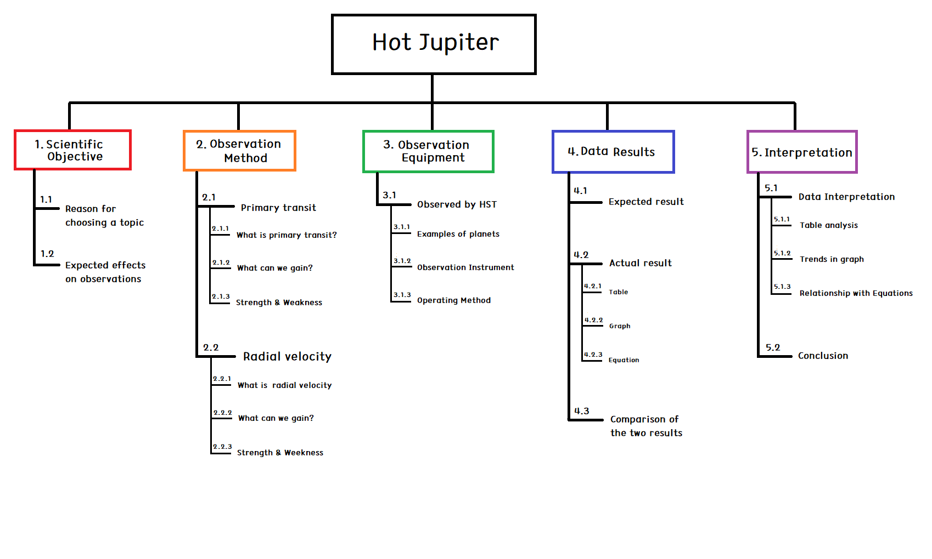
PLAN
Week 7 : Total WBS introduction / Scientific Objective 1.1, 1.2
Week 8 : Modifying overall WBS and PLAN / Observation Method 2.1, 2.2, 2.3
Week 9 : Observation Method 2.1, 2.2
Week 10 : Observation Equipment 3.1
Week 11 :
Week 12 : Data Result 4.1
Week 13 : Data Result 4.2, 4.3
Week 14 : Interpretation 5.1, 5.2
Week 15 : (Blank Period)
Week 16 : Conference

Slide 3
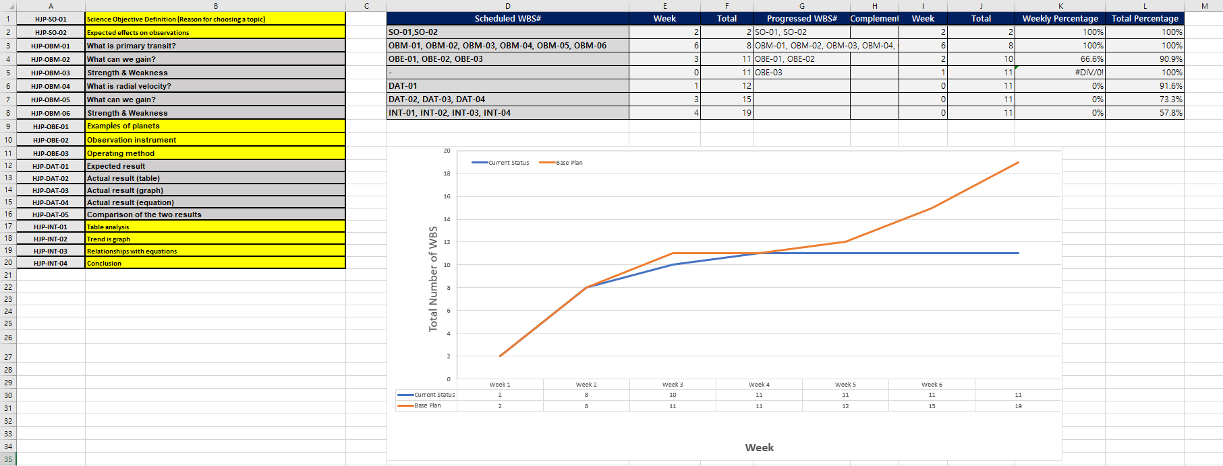
WBS

Slide 4
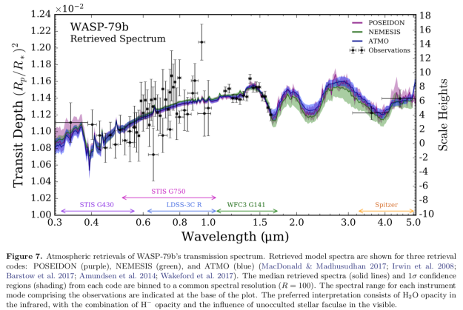
3.1.2
Observation Instrument

Slide 5
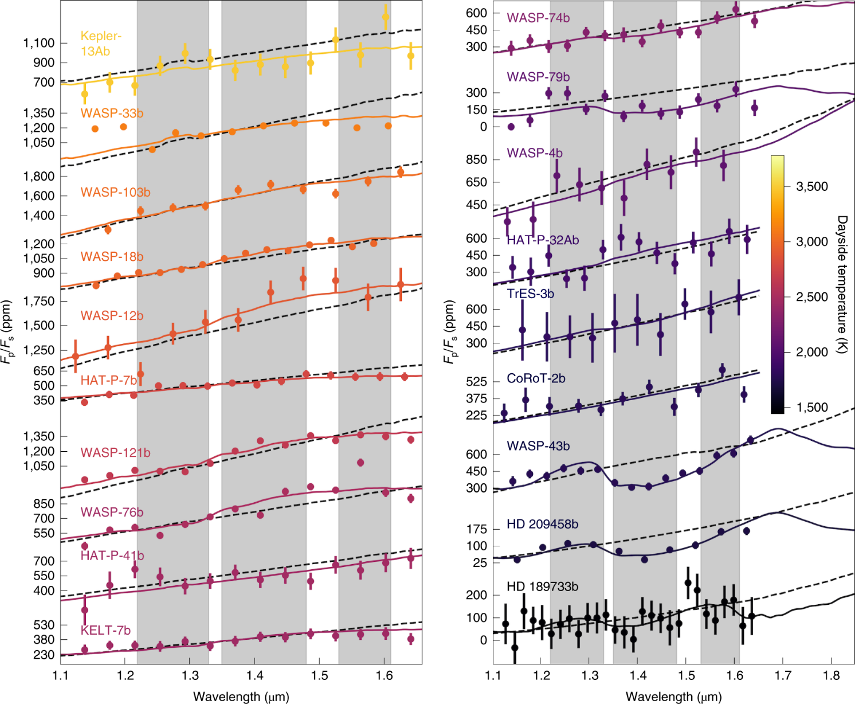
3.1.2
Observation Instrument – WFC3

Slide 6
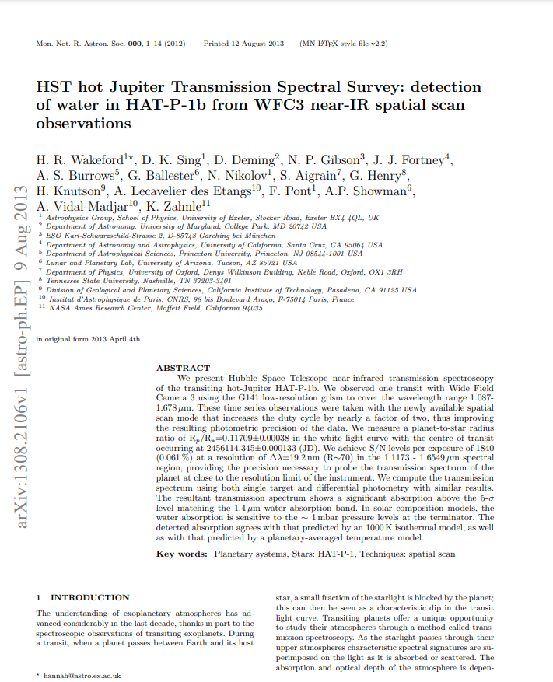
3.1.3
Operating method

Slide 7
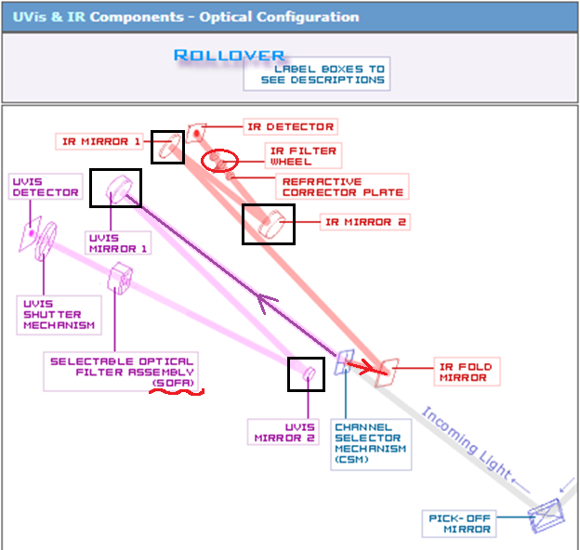
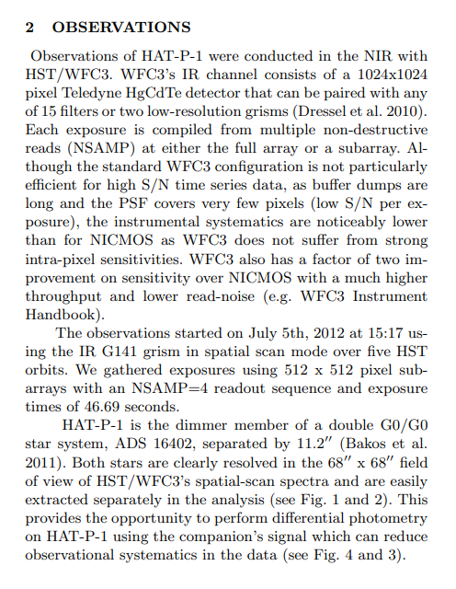
3.1.3
Operating method

Slide 8
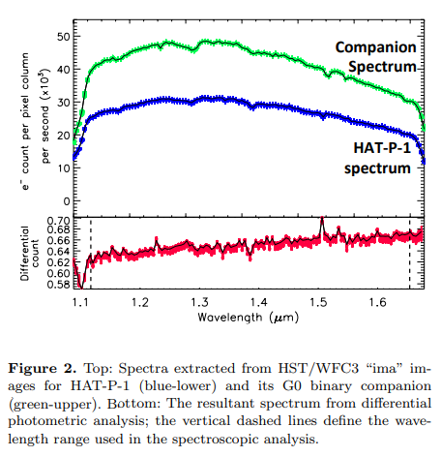
3.1.3
Operating method –
(1) Spatial scanning

Slide 9
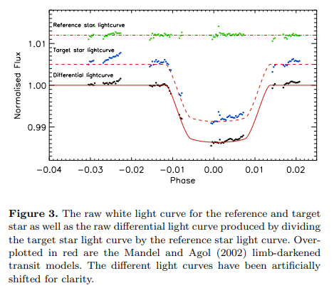
3.1.3
Operating method –
(2) Wavelength calibration

Slide 10
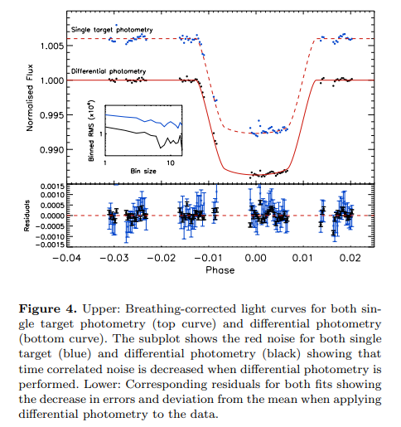
3.1.3
Operating method –
(3) Limb darkening

Slide 11
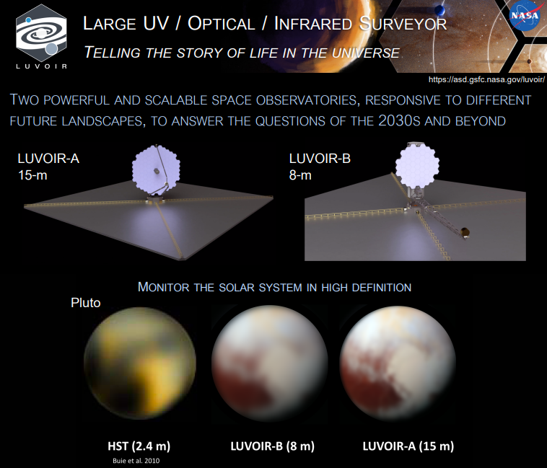
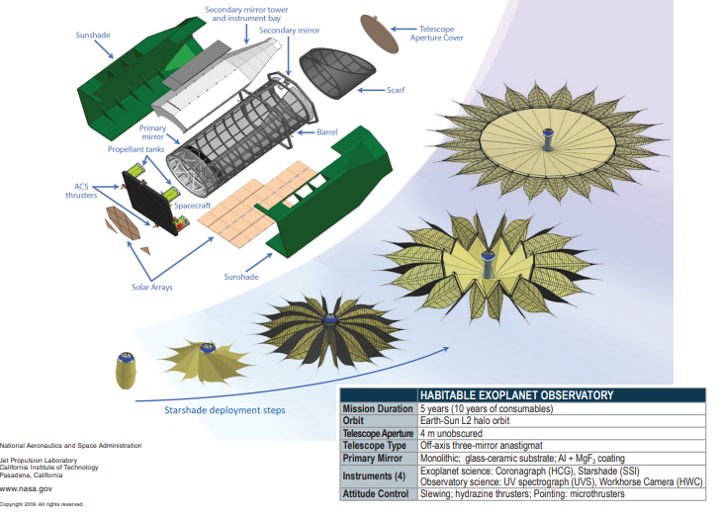
3.1.3
Habex
Luvoir

Slide 12
THANK YOU
FOR LISTENING

